Slide 1
Analysis of 911 Call Reason in Toronto 2017
Kyle Lee
May 2019

Slide 2
introduction
The internationally accepted standard for answering 911 calls suggests 90% of all calls should be picked up within 10 seconds, or 95% calls should be answered within 20 seconds even during the busiest time of day.
A significant wait time was reported in the city of Toronto, maximum wait time up to 5 min.
Main evaluation of the data
Categorizing top call reasons
Clustering the most frequent call reported by intersections
Determining which neighborhood is safter in downtown Toronto

Slide 3
Data description
Data was collected from the public Toronto city website
1. Fire Station Locations - City of Toronto fire station location (XY coordinates)
https://www.toronto.ca/city-government/data-research-maps/open-data/open-data-catalogue/#8b80c323-f37b-d861-28cc-66103b4e1619
2. 2011-2017 Basic Incidents Details - All 911 call response from 2017
https://www.toronto.ca/city-government/data-research-maps/open-data/open-data-catalogue/#a1e46b64-f831-f7fa-5504-3410a8d1df53
Master Dataframe has 8952 rows and 17 Key features
All null values were dropped.

Slide 4
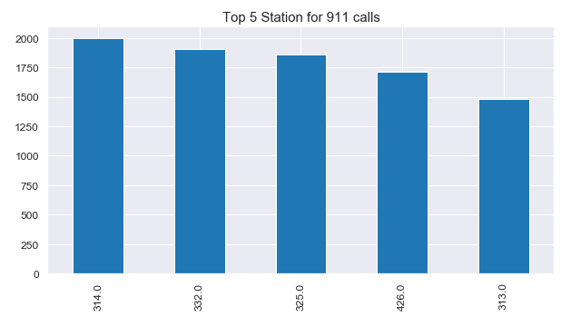
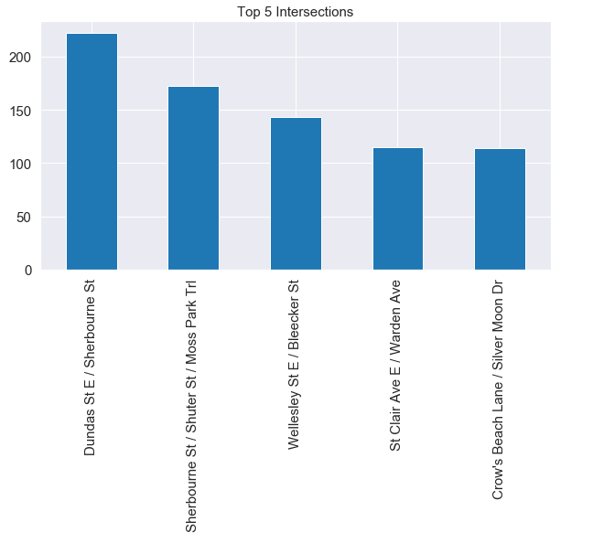
Top 5 results for 911 call response

Slide 5
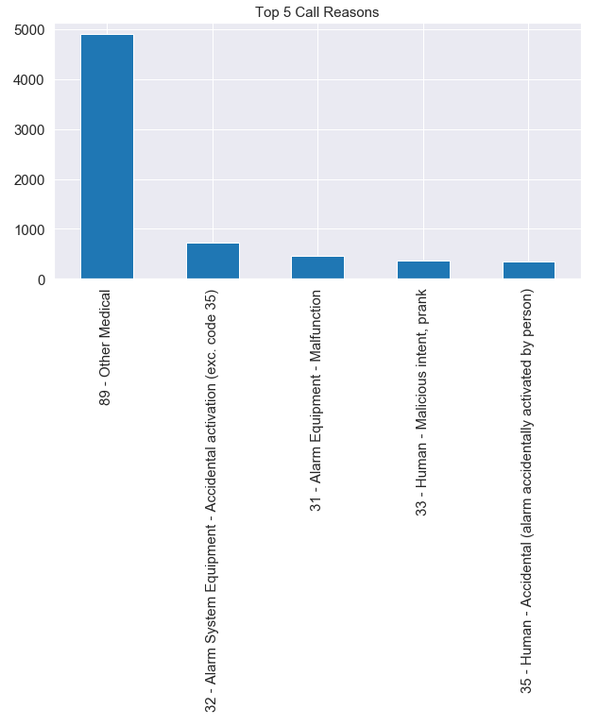
Top 5 results for 911 call response

Slide 6
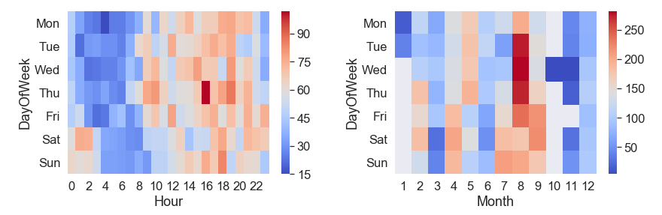
911 frequency

Slide 7
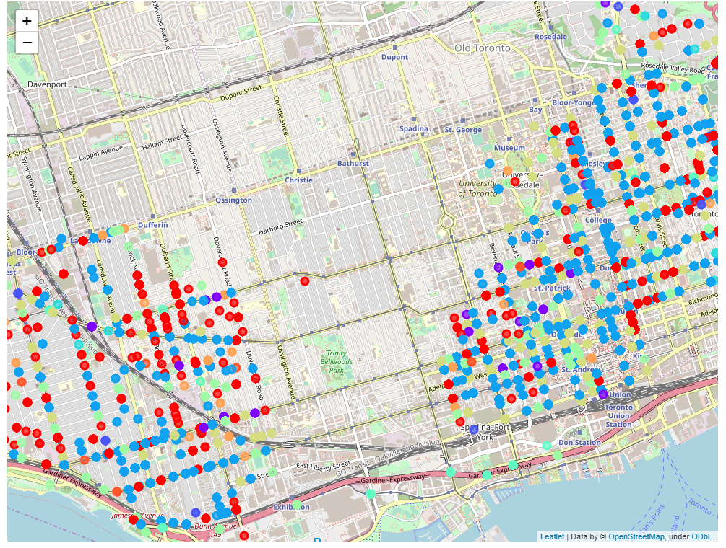

Toronto map

Slide 8
Conclusion
The major 911 call reasons can be divided into 3 groups:
1) medical
2) accidental or malfunction of the alarm system
3) Human prank or accidental press
Based on the cluster map, the East Toronto area, especially along the Sherbourne St., the major 911 calls were reported.
Possible bias in result due to large volume of working data set
Optimizing Kmean to have better K cluster based on the post code could give better categorization of the call reason

